Slide 1

All Year Olympics Data Review
Subtitle or company info

Slide 2
Team
Do you believe 1128 Teams participated in Olympics every year.
Do you want find which teams won more Medals in Olympics
Then Let’s go…………..

Slide 3
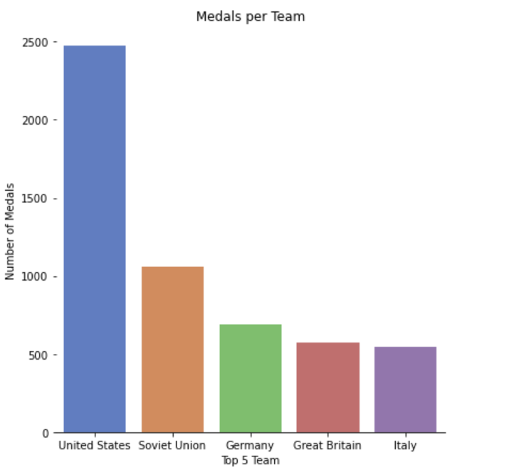
Here we see Top 5 Team Won Medals
Top 5 Teams are:

Slide 4
Gender
Sport is one of the most powerful platforms for promoting gender equality
Let’s See the percentage of both genders in Olympics.

Slide 5
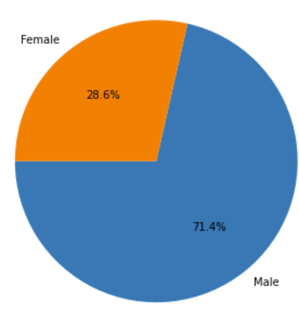
The percentage of Men & Women
The Percentage of Women is less when compared with Men but now a days the percentage is gradually increasing(next slide).

Slide 6
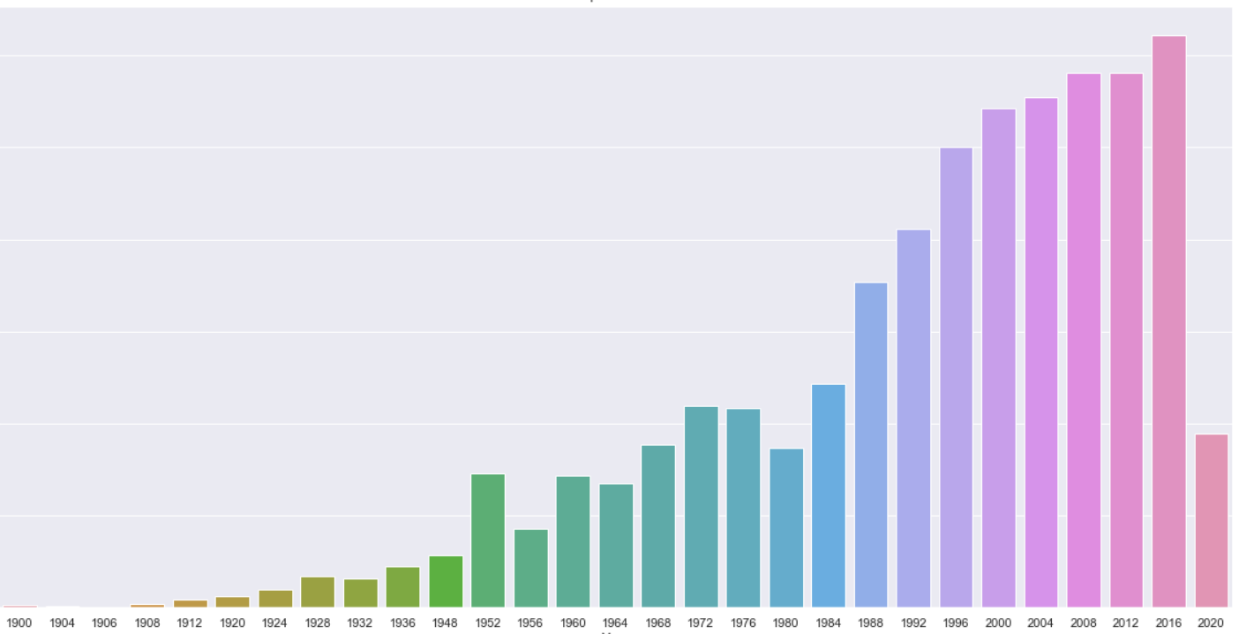
When do women started coming into the Olympics?
Although Olympics started in the year 1896, Female participants are from 1900.

Slide 7
Age
Do you know in Olympics there are participants in the Age of 97yrs.
Are you Interested to see the data of that participants.
Let’s See…………………

Slide 8
Here we see the 97 Age Male person Participated in the year 1928.
There are many elder citizens Participated in the Olympics.

Slide 9
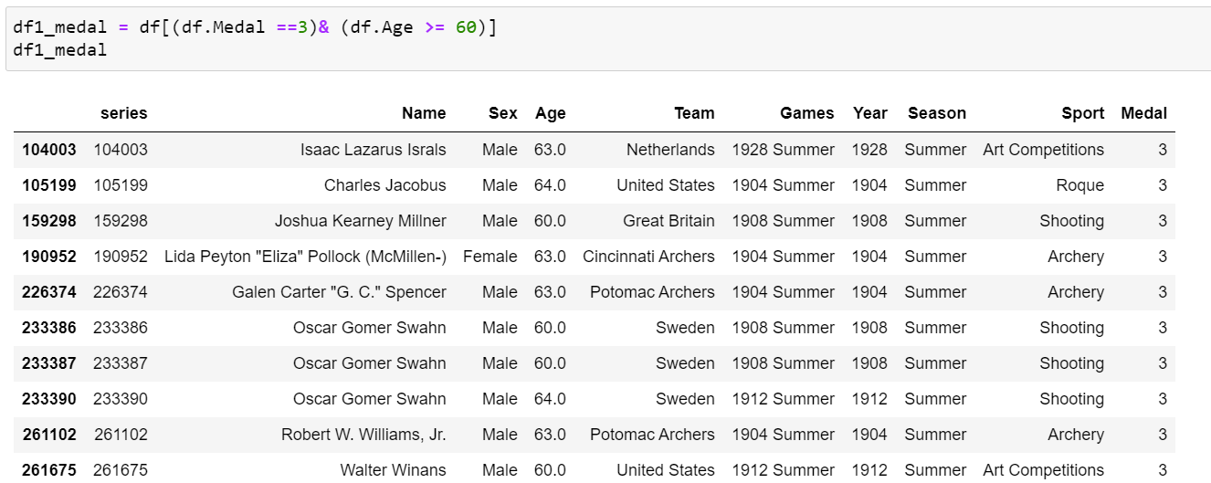
Here we see the Players who are in Olympics above Age of 60 & Won Medal 3

Slide 10
Seasons
In Olympics we have Two Seasons
Summer & Winter
Let’s see in which Seasons we have more Sports

Slide 11
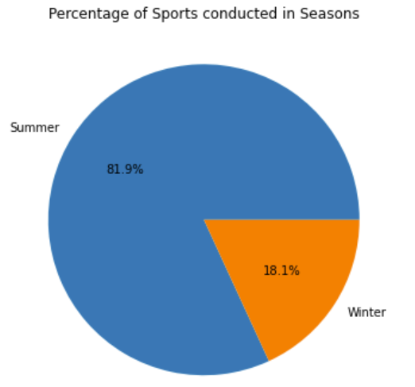
Summer has more Sports when compared to winter

Slide 12
Sports
We have Number of Sports in Olympics.
Let’s see the percentage of sports…….

Slide 13
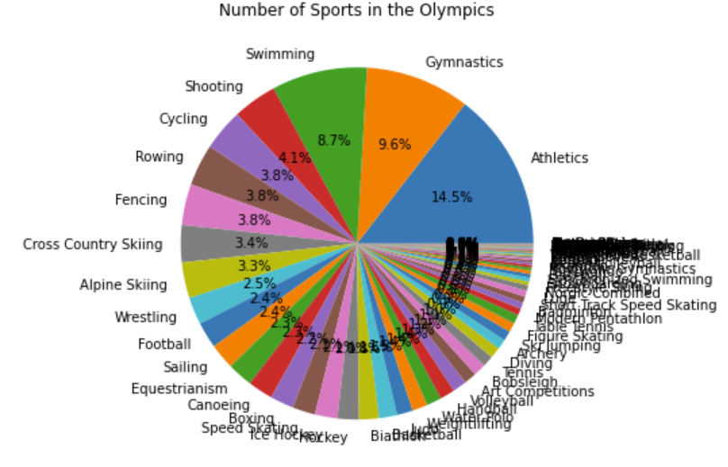
Athletics have more percentage when compared to all sports.

Slide 14
Year
Olympic was Started in the year 1896 as per records.
Let’s See which Countries won more Medals in the last held Olympics……

Slide 15
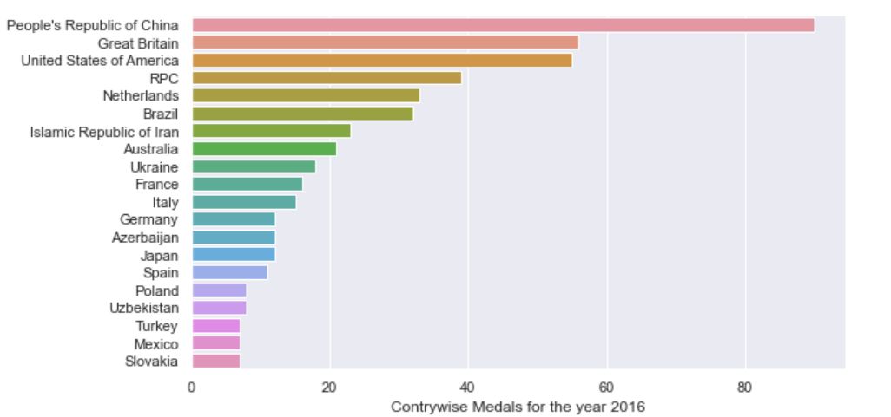
In 2020 The more medals won by China

Slide 16
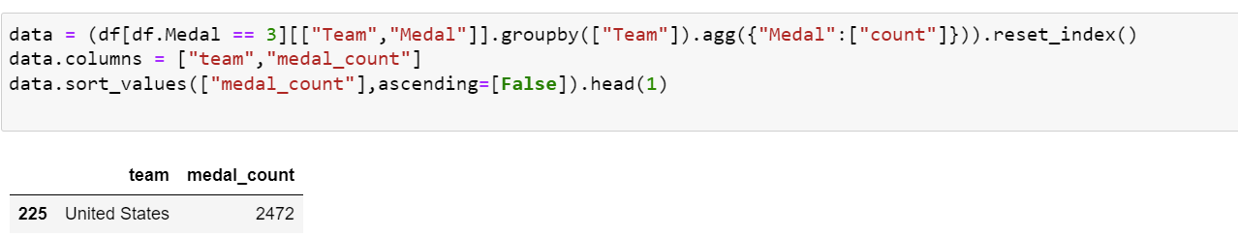
Medals
Let’s See the Maximum Medal 3 Won by which Country

Slide 17
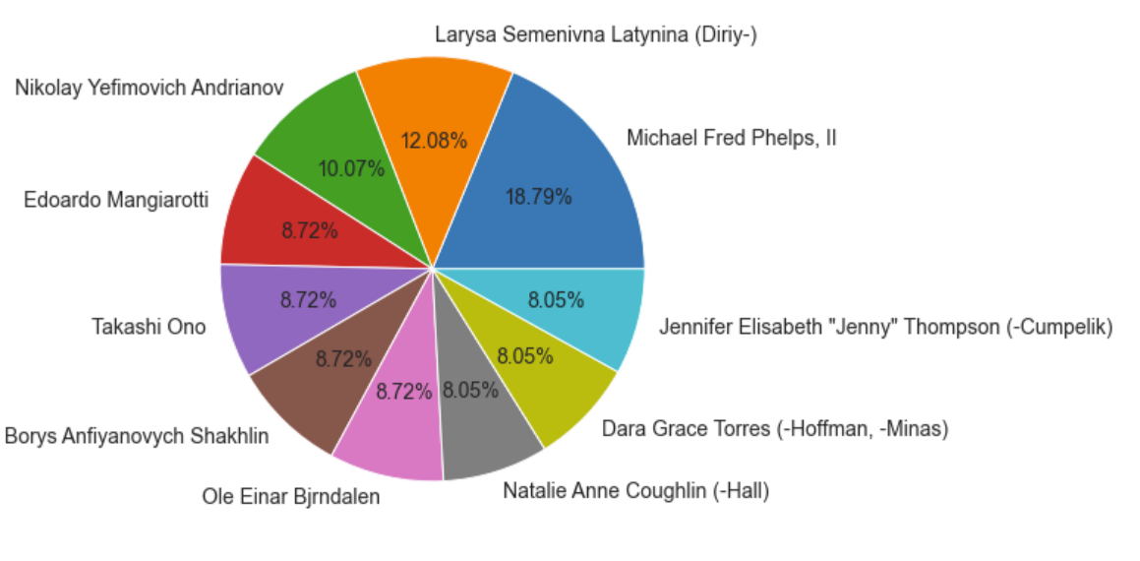
Top 10 Players
Here We see the Top 10 Players who won more Medals in Olympics.

Slide 18
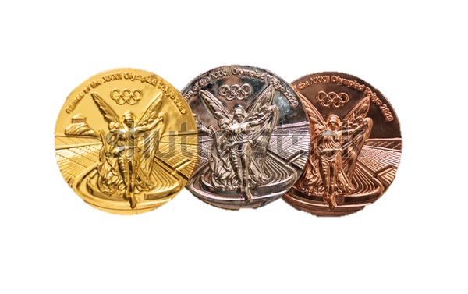
Thank You

